Slide 1
Machine Learning for Neuroscience
Ensemble models and kernel based models
Payam Barnaghi
Department of Brain Sciences
Imperial College London
Autumn 2022
Notes:
1

Slide 2

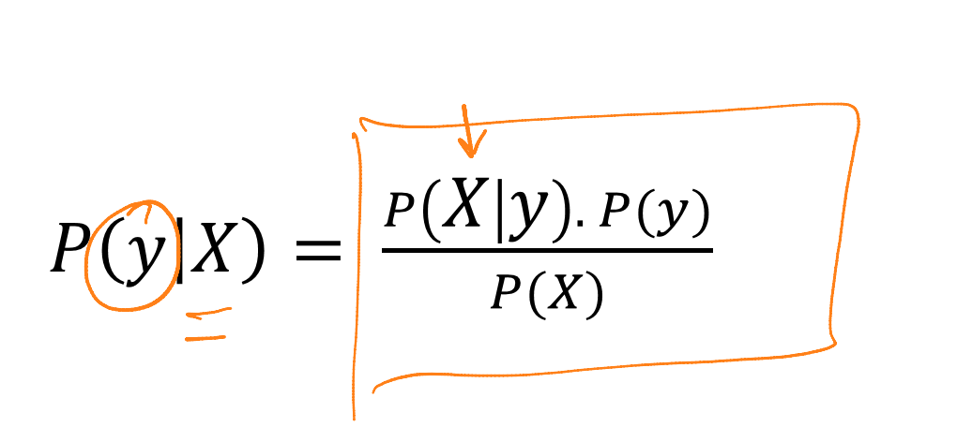
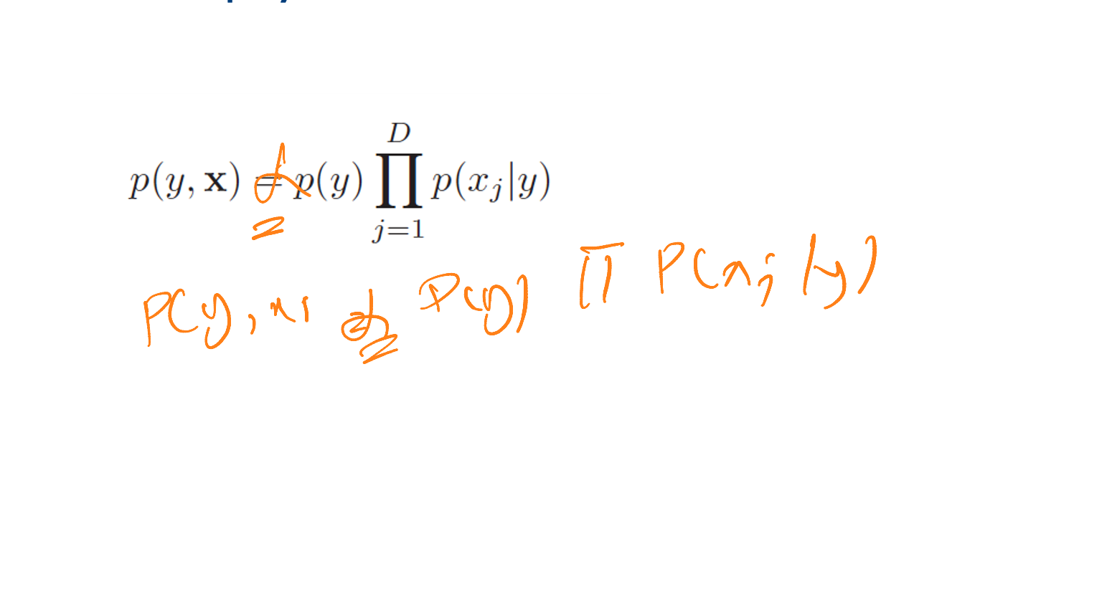



Errata – from lecture 4 (Bayesian models)
When I said it is proportional I made a mistake; this is in fact is equal to because the right hand side is p(y, x) and not p(y|x).

Slide 3
Feature Vectors
So far we have been assuming that each item that we wish to classify or cluster or process can be represented as a fixed-size feature vector.
However, for certain types of items/concepts, it is not clear how to best represent them as fixed-sized feature vectors.
For example, how do we represent a text document or protein sequence, which can be of variable length? or a molecular structure, which has complex 3d geometry? or an evolutionary tree, which has variable size and shape?

Slide 4
Kernel functions
One approach to the latter problem is to assume that we have some way of measuring the similarity between items, that doesn’t require pre-processing them into feature vector format.
For example we can apply a function to transform the original data into a higher dimensional space in which the data items can then be compared/processed.
This process can be done via kernel functions.

Slide 5
Linear separability
We have also often assumed that the data items are lineally separable; but what if the data was not linearly separable.
In this case, we can again apply a kernel that maps each data instance (from the original non-linear observation space) into a higher-dimensional space in which in this new space the data instances become separable.

Slide 6
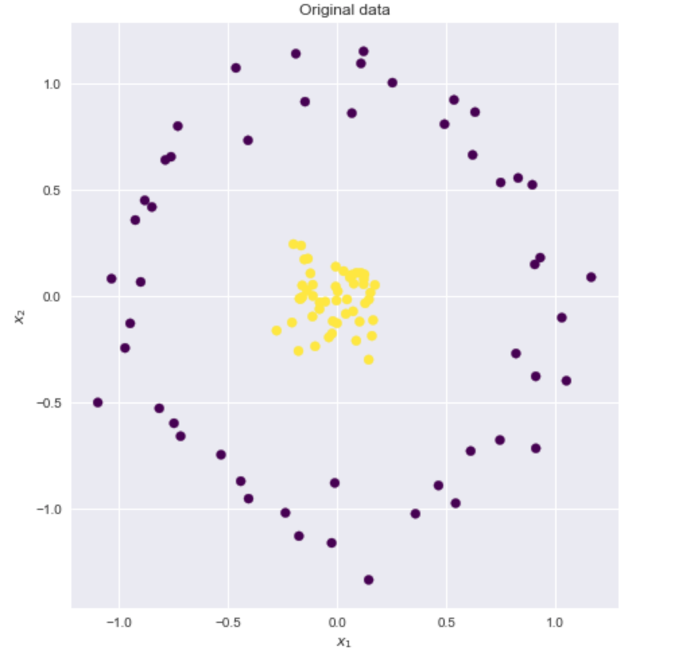
Example
Source: https://xavierbourretsicotte.github.io/Kernel_feature_map.html

Slide 7
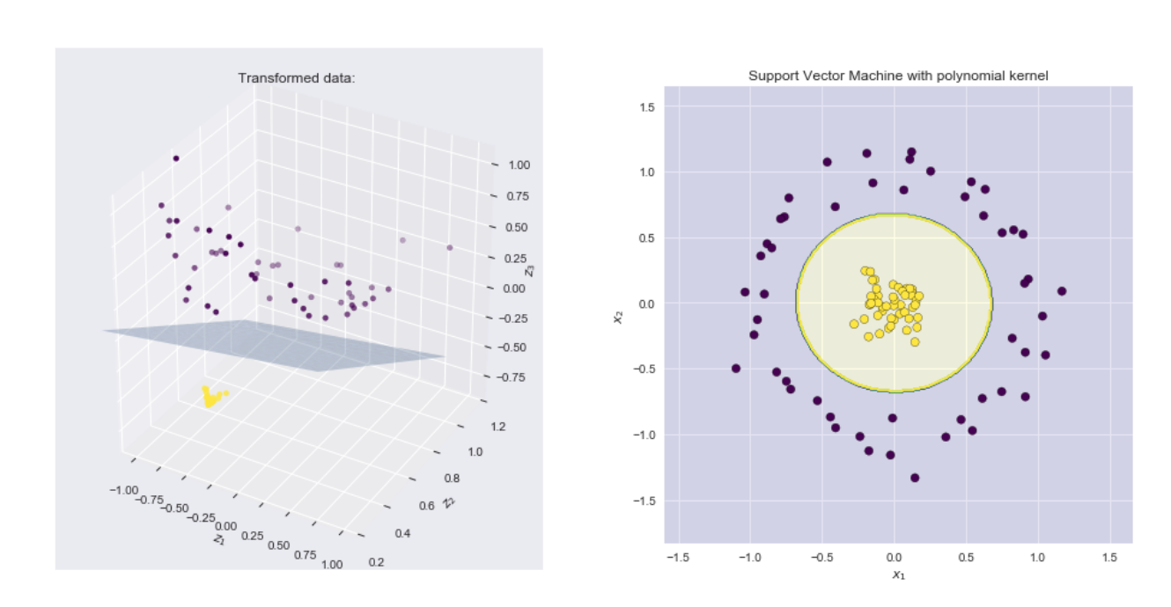
Example – applying polynomial kernel
Source: https://xavierbourretsicotte.github.io/Kernel_feature_map.html

Slide 8
What is a polynomial kernel?
If our data is a set of (x₁, x₂)
Transform it to (z₁,z₂,z₃) in which:
z₁ = x₁;
z₂ = x₂;
z₃ = x₁² + x₂²
(z₁,z₂,z₃)= (x₁, x_{2,} ,x₁² + x₂²)
This is in fact sum of polynomials

Slide 9
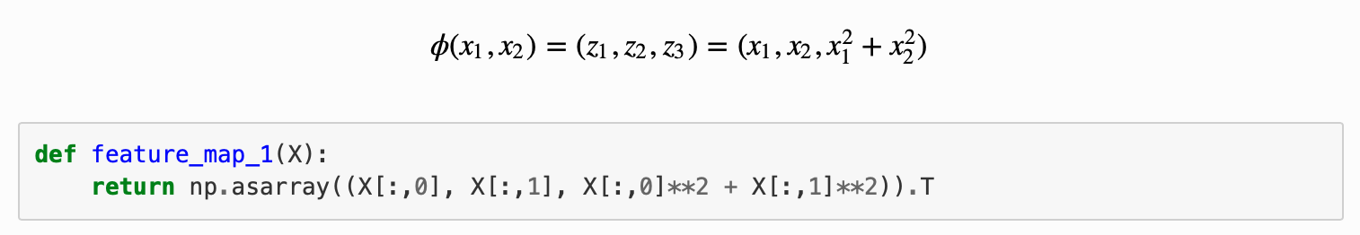
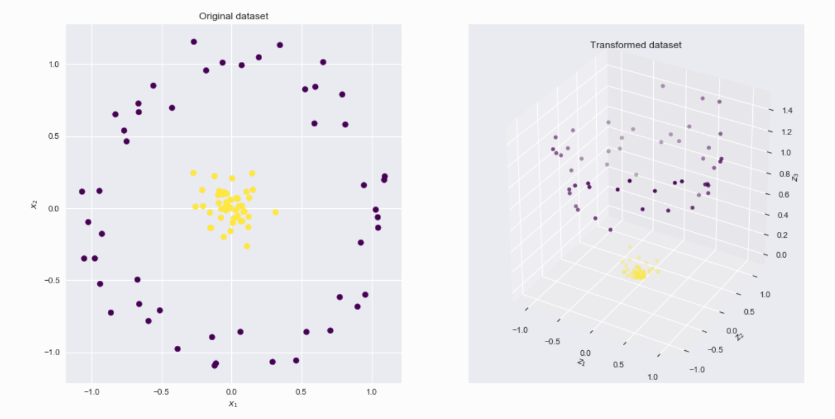
A polynomial kernel
Source: https://xavierbourretsicotte.github.io/Kernel_feature_map.html

Slide 10
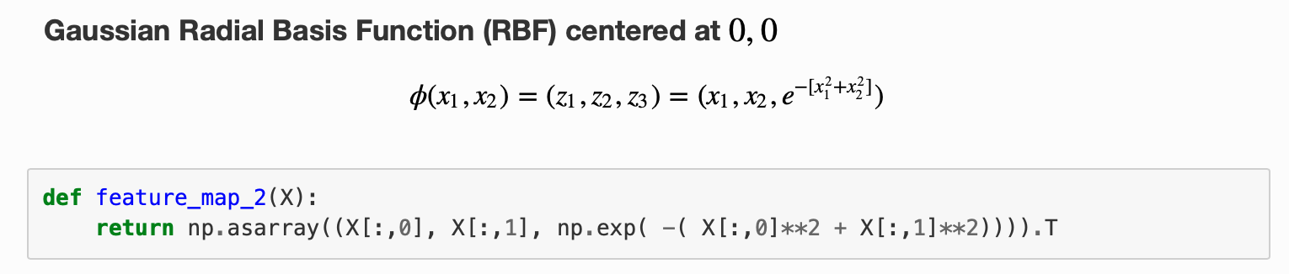
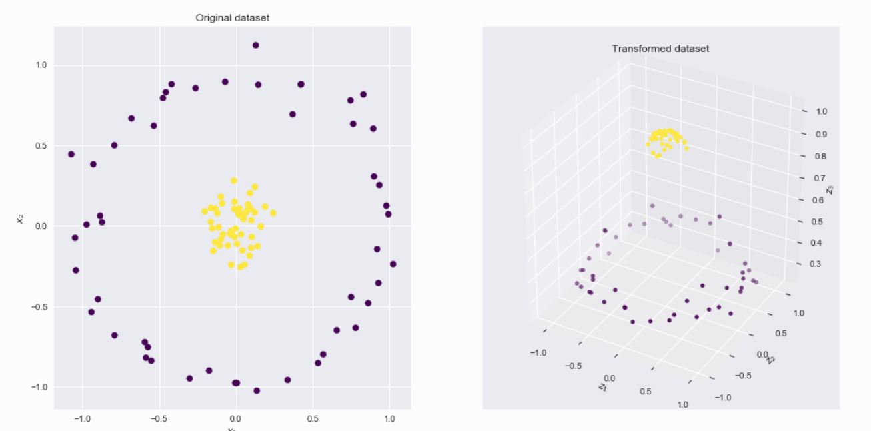
Gaussian Radial Basis Function (RBF)
Source: https://xavierbourretsicotte.github.io/Kernel_feature_map.html

Slide 11
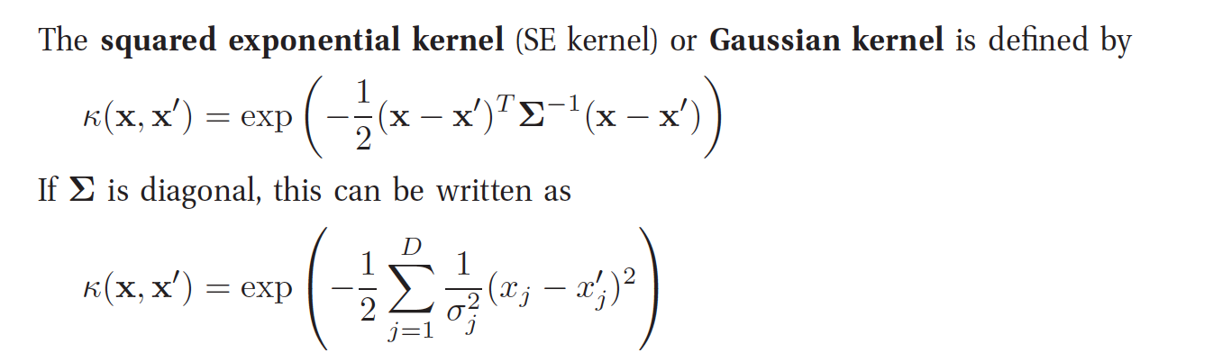
RBF Kernel in more generalised form*
Source: Kevin Murphy, Machine Learning: A probabilistic Approach, MIT Press.

Slide 12
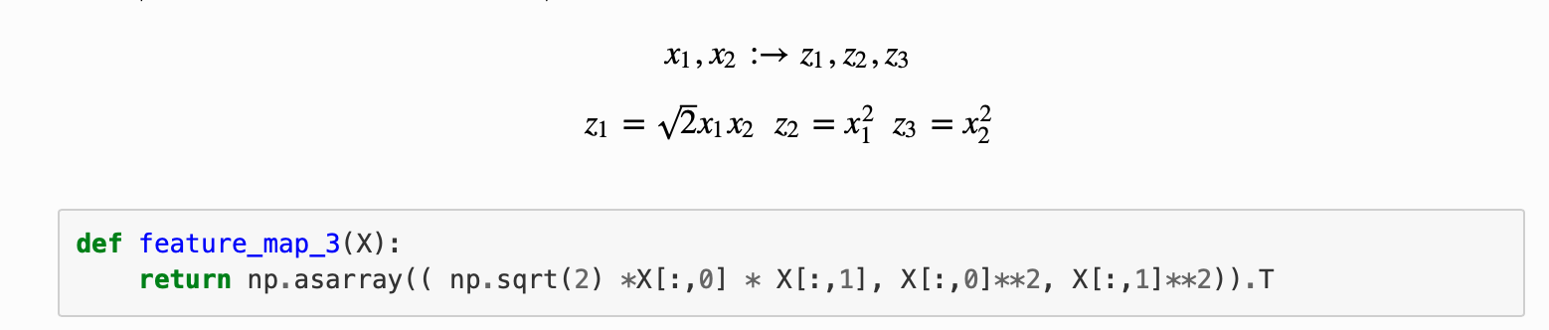
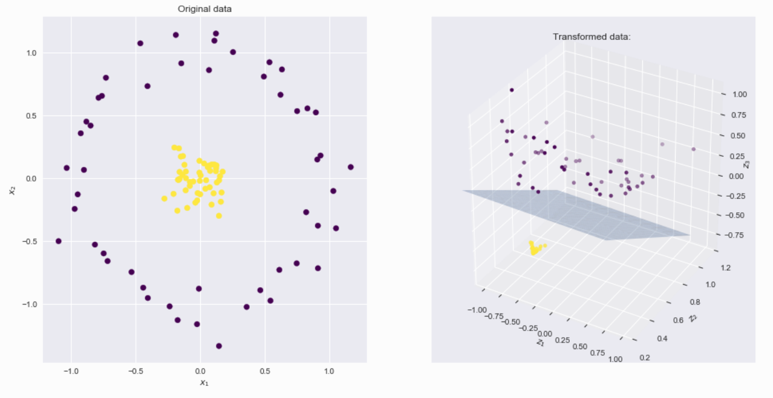
Another polynomial function
Source: https://xavierbourretsicotte.github.io/Kernel_feature_map.html

Slide 13
Support Vector Machines
Support vector machines (SVMs) are a set of supervised learning methods used for classification, regression and outliers detection.
The advantages of support vector machines are:
Effective in high dimensional spaces.
Still effective in cases where number of dimensions is greater than the number of samples.
Uses a subset of training points in the decision function (called support vectors), so it is also memory efficient.
Versatile: different Kernel functions can be specified for the decision function. Common kernels are provided, but it is also possible to specify custom kernels.
Source: Scikit learn

Slide 14
SVM - disadvantages
The disadvantages of support vector machines include:
If the number of features is much greater than the number of samples, the method is likely to give poor performances.
SVMs do not directly provide probability estimates.

Slide 15
SVM Classifier
A Support Vector Machine (SVM) is a discriminative classifier formally defined by a separating hyperplane.
In other words, given labelled training data (supervised learning), the algorithm outputs an optimal hyperplane which categorizes new examples.
e.g. For a linearly separable set of 2D-points which belong to one of two classes, find a separating straight line.

Slide 16
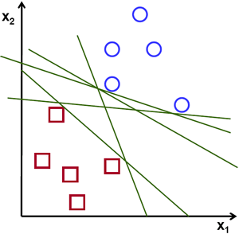
SVM Example
Source: https://vovkos.github.io/doxyrest-showcase/opencv/sphinx_rtd_theme/page_tutorial_introduction_to_svm.html

Slide 17
Linear separation
In this example we deal with lines and points in the Cartesian plane instead of hyperplanes and vectors in a high dimensional space.
This is a simplification of the problem.
It is important to understand that this is done only because our intuition is better built from examples that are easy to imagine.
However, the same concepts apply to tasks where the examples to classify lie in a space whose dimension is higher than two.
Source: https://vovkos.github.io/doxyrest-showcase/opencv/sphinx_rtd_theme/page_tutorial_introduction_to_svm.html

Slide 18
SVM – linear separation
We can intuitively define a criterion to estimate the worth of the lines:
A line is bad if it passes too close to the points because it will be noise sensitive and it will not generalize correctly. Therefore, our goal should be to find the line passing as far as possible from all points.
Then, the operation of the SVM algorithm is based on finding the hyperplane that gives the largest minimum distance to the training examples.
This distance receives the important name of margin within SVM’s theory. Therefore, the optimal separating hyperplane maximizes the margin of the training data.
Source: https://vovkos.github.io/doxyrest-showcase/opencv/sphinx_rtd_theme/page_tutorial_introduction_to_svm.html

Slide 19
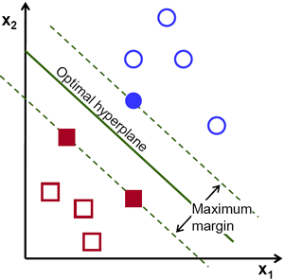
Example: SVM for a linearly separable set of 2d-points
Source: https://vovkos.github.io/doxyrest-showcase/opencv/sphinx_rtd_theme/page_tutorial_introduction_to_svm.html

Slide 20
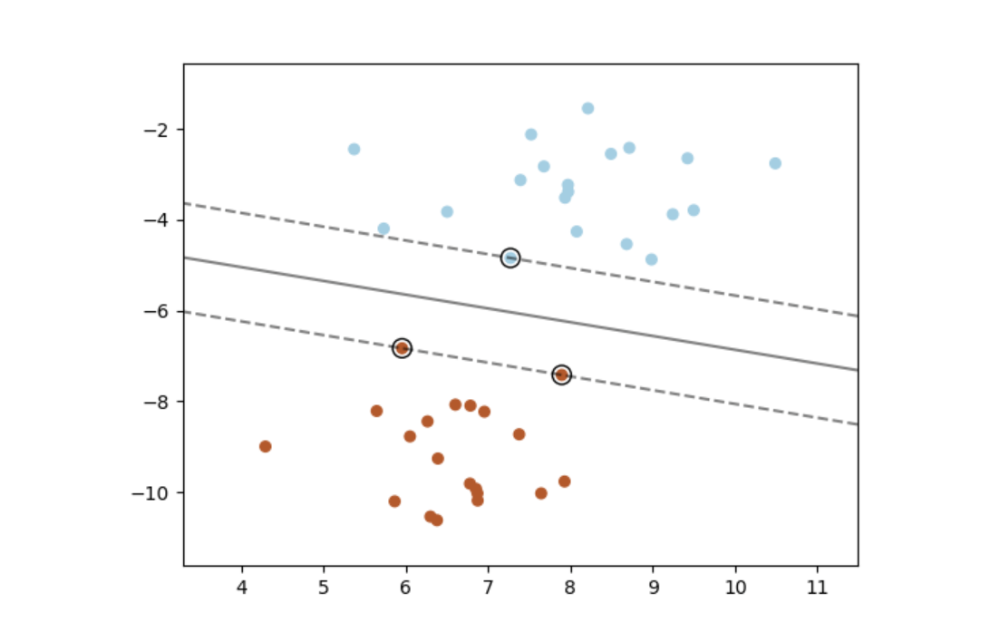
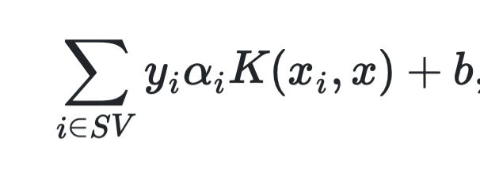
Mathematical formulation*
Source: https://scikit-learn.org/stable/modules/svm.html

Slide 21
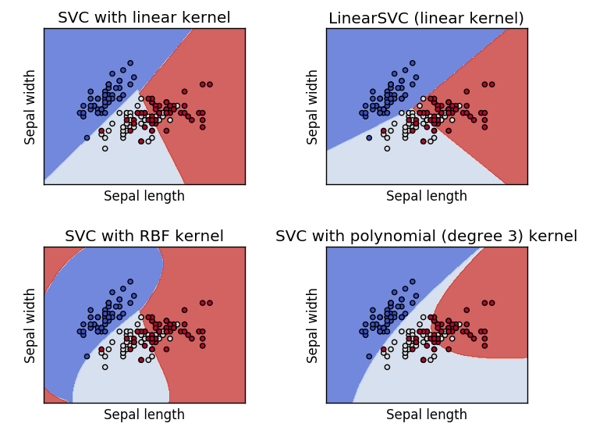
SVM with different kernels
Source: https://vovkos.github.io/doxyrest-showcase/opencv/sphinx_rtd_theme/page_tutorial_introduction_to_svm.html

Slide 22
Decision Trees
A decision tree model is an interpretable model in which the final output is based on a series of comparisons of the values of predictors against threshold values.
DTs are made up of nodes, branches, and leaves.
Each node represents a feature, each branch a choice, and each leaf an outcome.
DTs take a top-down approach to data, attempting to group and classify observations that are similar amongst them and searching for the optimal criteria to partition the observations that are dissimilar until they reach a particular level of similarity.

Slide 23
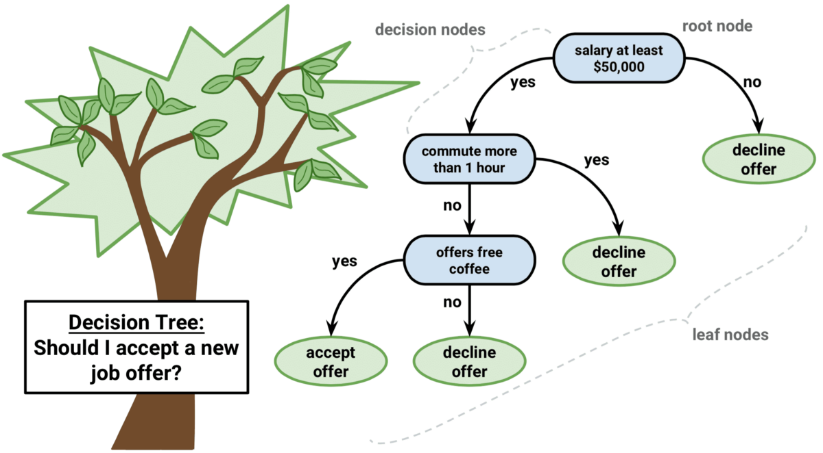
Decision Trees - Example
Source: https://regenerativetoday.com/simple-explanation-on-how-decision-tree-algorithm-makes-decisions/

Slide 24
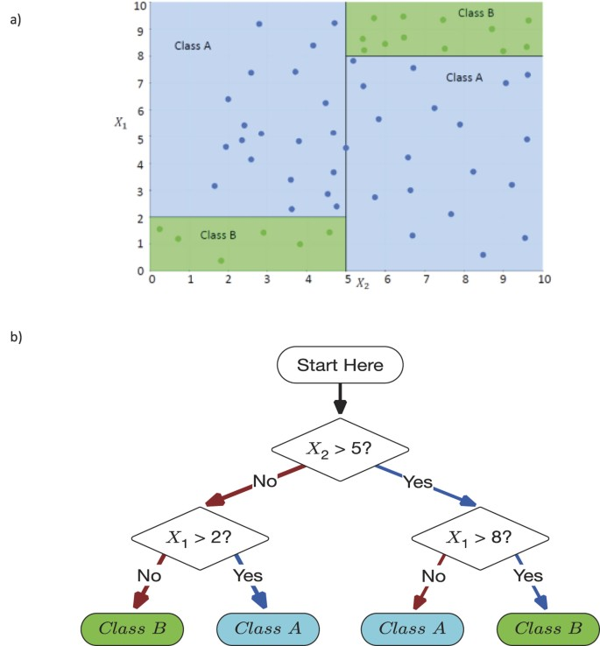
Decision Making Using DTs
Source: Valdes, G., Luna, J., Eaton, E. et al. MediBoost: a Patient Stratification Tool for Interpretable Decision Making in the Era of Precision Medicine. Sci Rep 6, 37854 (2016). https://doi.org/10.1038/srep37854

Slide 25
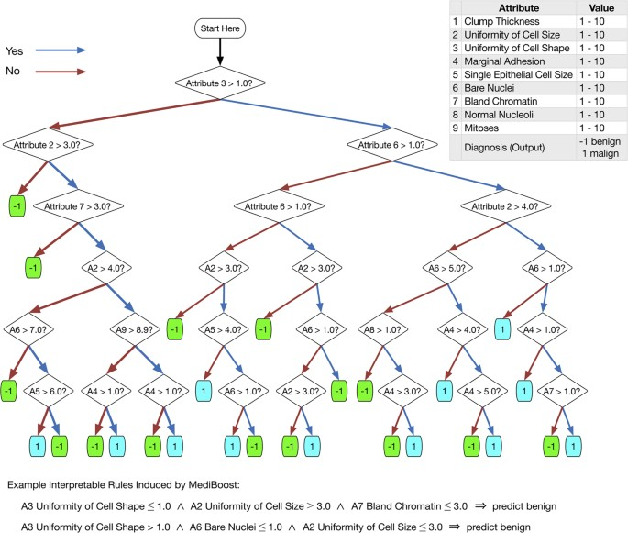
DTs in Clinical Applications
Source: Valdes, G., Luna, J., Eaton, E. et al. MediBoost: a Patient Stratification Tool for Interpretable Decision Making in the Era of Precision Medicine. Sci Rep 6, 37854 (2016). https://doi.org/10.1038/srep37854

Slide 26
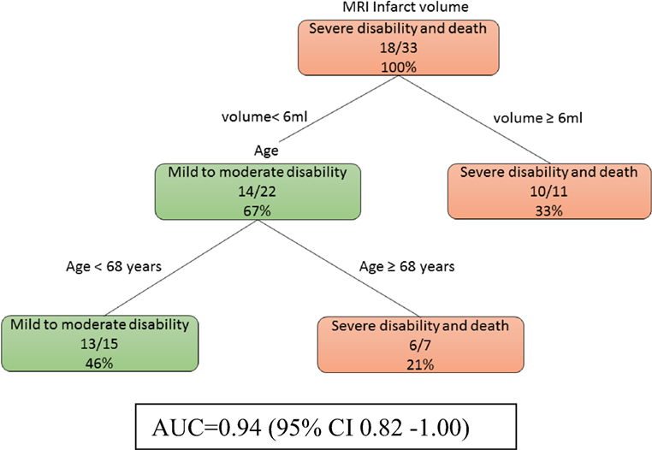
A decision tree model in TBI
Source: Phan, T. G., Chen, J., Singhal, S., Ma, H., Clissold, B. B., Ly, J., & Beare, R. (2018). Exploratory Use of Decision Tree Analysis in Classification of Outcome in Hypoxic–Ischemic Brain Injury. Frontiers in Neurology, 9. https://doi.org/10.3389/fneur.2018.00126

Slide 27
Learning decision trees
Decision Trees (DTs) are a non-parametric supervised learning method used for classification and regression.
The goal is to create a model that predicts the value of a target variable by learning simple decision rules inferred from the data features.
A tree can be seen as a piecewise constant approximation.
Source: https://scikit-learn.org/stable/modules/tree.html

Slide 28
Learning decision trees
There are different algorithms to learn decision tree structure from the data.
In principle these algorithms start with a root node in the tree structure and explore the features in the data and create rules that can separate the data one step at a time.
One of the basic algorithms is ID3.

Slide 29
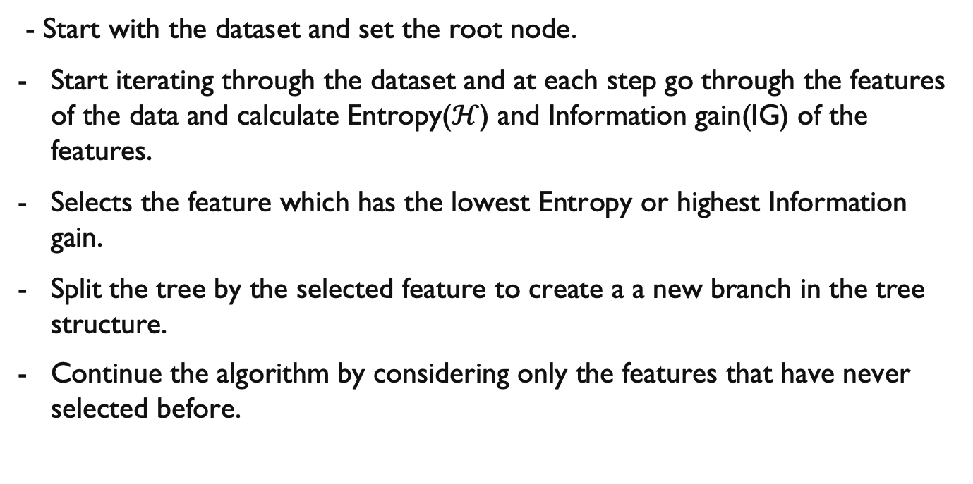
The ID3 algorithms
- Start with the dataset and set the root node.
Start iterating through the dataset and at each step go through the features of the data and calculate Entropy($ℋ$) and Information gain(IG) of the features.
Selects the feature which has the lowest Entropy or highest Information gain.
Split the tree by the selected feature to create a a new branch in the tree structure.
Continue the algorithm by considering only the features that have never selected before.

Slide 30
Decision Trees - Limitations
Prone to overfit
Poor generalisation performances
High variance
a slight change in the data can result in a completely different set of splits, which can make interpretation difficult
Can be inherently unstable
the effect of an error in the top splits propagates down to all of the splits below due to their hierarchical nature
Produce biased trees for unbalanced dataset

Slide 31
How to overcome these limitations?
Ensemble:
Single DT is fast but does not perform well
Learn from multiple trees
Need to be careful to not learn the same
Bagging:
Bootstrap aggregating, a method that results in low variance
Construct N trees and learn a classifier for each bootstrap sample and average them
Can improve the accuracy of unstable models that tend to overfit
Feature Randomness:
Feature bagging generates a random subset of features, which ensures low correlation among models

Slide 32
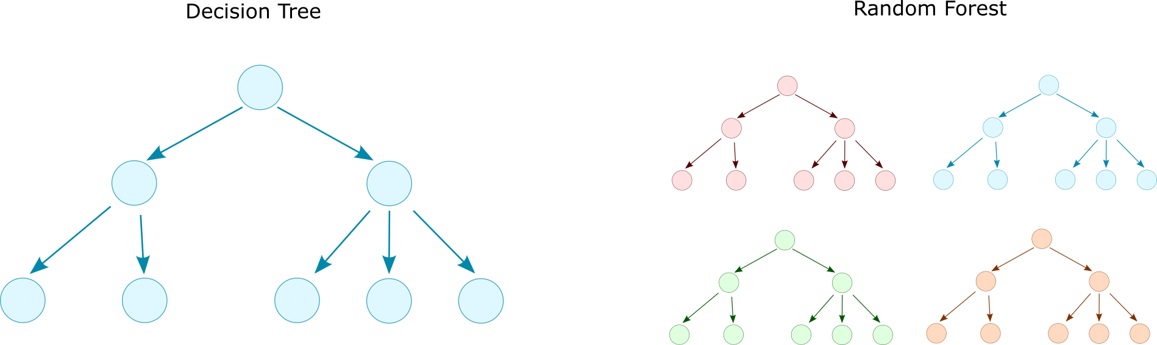
Random Forest
Random Forest was introduced in 2001to overcome these issues [1].
Ensemble model consisting of multiple decision trees
Majority vote
[1] Breiman, Leo. "Random forests." Machine learning 45.1 (2001): 5-32.

Slide 33
Ensemble models
The goal of ensemble methods is to combine the predictions of several base estimators built with a given learning algorithm in order to improve generalisability / robustness over a single estimator.
Two families of ensemble methods are usually distinguished:
Averaging methods
Boosting methods
Source: https://scikit-learn.org/stable/modules/ensemble.html

Slide 34
Averaging methods
In averaging methods, the driving principle is to build several estimators independently and then average their predictions.
On average, the combined estimator is usually better than any single base estimator because its variance is reduced.
Examples: Bagging methods
Source: https://scikit-learn.org/stable/modules/ensemble.html

Slide 35
Bagging
Bagging methods come in many flavours but mostly differ from each other by the way they draw random subsets of the training set:
When random subsets of the dataset are drawn as random subsets of the samples, then this algorithm is known as Pasting.
When samples are drawn with replacement, then the method is known as Bagging.
When random subsets of the dataset are drawn as random subsets of the features, then the method is known as Random Subspaces.
Finally, when base estimators are built on subsets of both samples and features, then the method is known as Random Patches.
In scikit-learn, bagging methods are offered as a unified BaggingClassifier meta-estimator (resp. BaggingRegressor), taking as input a user-specified estimator along with parameters specifying the strategy to draw random subsets.
Source: https://scikit-learn.org/stable/modules/ensemble.html

Slide 36
Boosting methods
By contrast, in boosting methods, base estimators are built sequentially, and one tries to reduce the bias of the combined estimator.
The motivation is to combine several weak models to produce a powerful ensemble.
Examples: AdaBoost, Gradient Tree Boosting
Source: https://scikit-learn.org/stable/modules/ensemble.html

Slide 37
Random Forests
In random forests, each tree in the ensemble is built from a sample drawn with replacement (i.e., a bootstrap sample) from the training set.
When splitting each node during the construction of a tree, the best split is found either from all input features or a random subset of size max_features.
The purpose of these two sources of randomness is to decrease the variance of the forest estimator.
Source: https://scikit-learn.org/stable/modules/ensemble.html

Slide 38
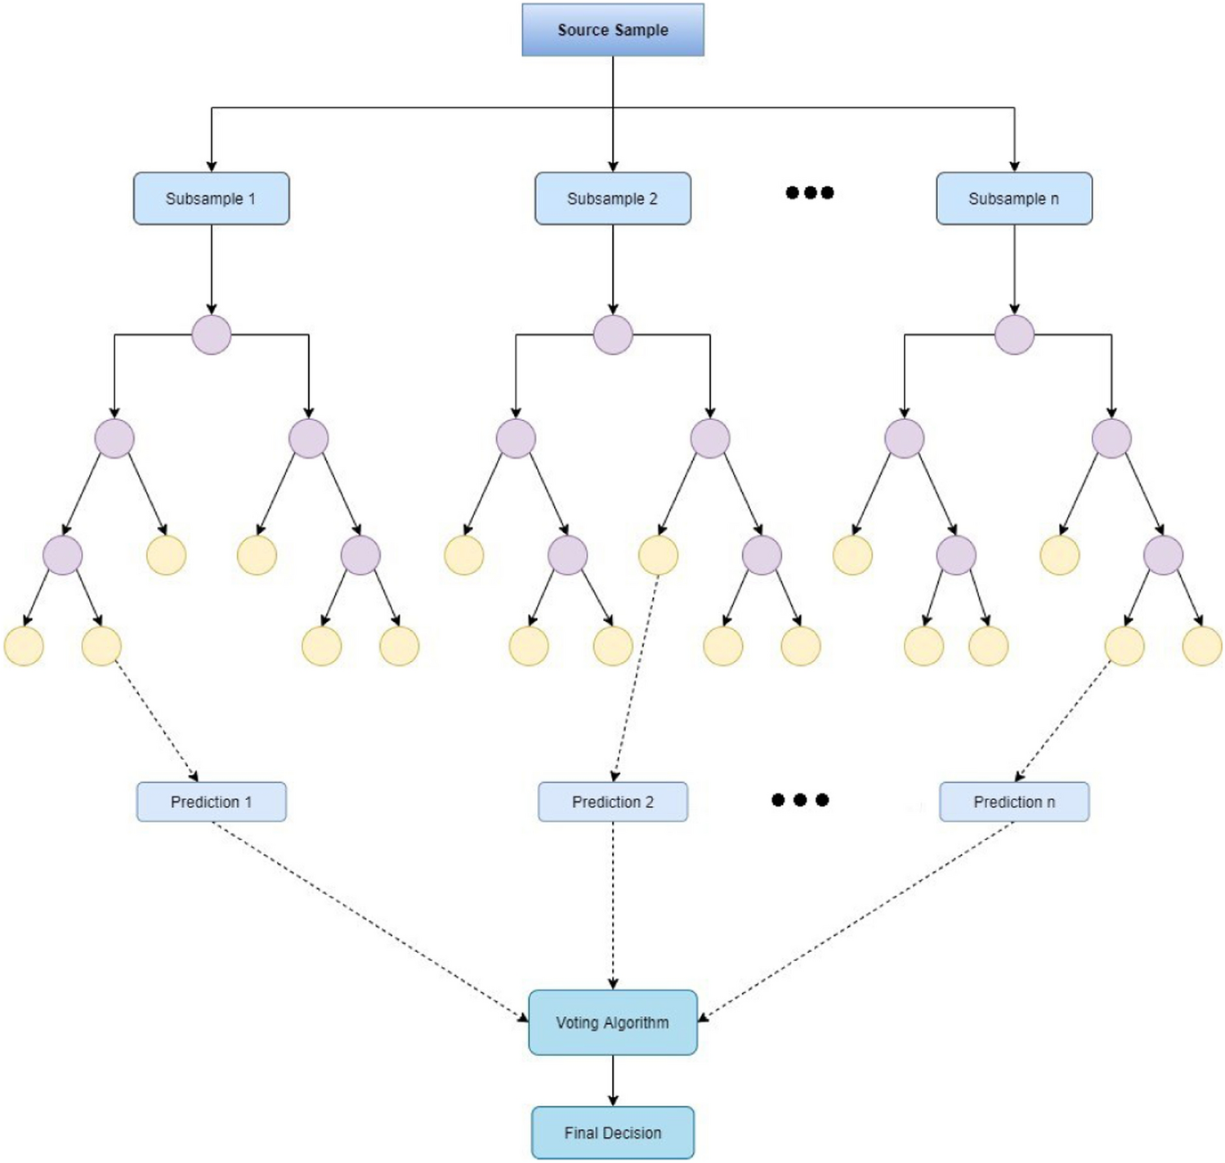
Structure of Random Forests
Source: Malebary, S.J., Khan, Y.D. Evaluating machine learning methodologies for identification of cancer driver genes. Sci Rep 11, 12281 (2021). https://doi.org/10.1038/s41598-021-91656-8

Slide 39
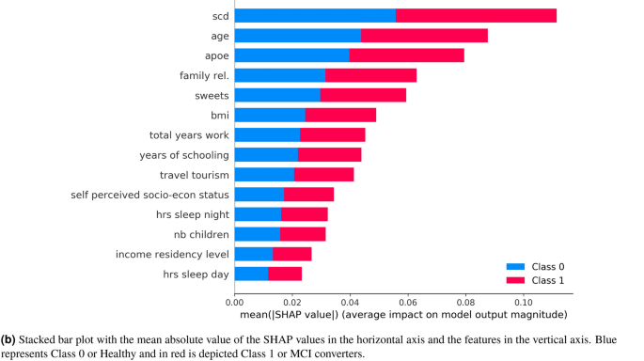
Example
Selecting the most important self-assessed features for predicting conversion to mild cognitive impairment with random forest and permutation-based methods:
Gómez-Ramírez, J., et al.(2020), https://doi.org/10.1038/s41598-020-77296-4

Slide 40
Random Forests
Individual decision trees typically exhibit high variance and tend to overfit.
The injected randomness in forests yields decision trees with somewhat decoupled prediction errors.
By taking an average of those predictions, some errors can cancel out. Random forests achieve a reduced variance by combining diverse trees, sometimes at the cost of a slight increase in bias.
Source: https://scikit-learn.org/stable/modules/ensemble.html

Slide 41
Practical note on RFs
In practice, the variance reduction is often significant, yielding an overall better model.
In contrast to the original publication [B2001], the scikit-learn implementation combines classifiers by averaging their probabilistic prediction, instead of letting each classifier vote for a single class.
Source: https://scikit-learn.org/stable/modules/ensemble.html

Slide 42
SHAP
SHAP (SHapley Additive exPlanations) is a game theoretic approach to explain the output of any machine learning model.
It connects optimal credit allocation with local explanations using the classic Shapley values from game theory and their related extensions.
See: https://github.com/slundberg/shap

Slide 43
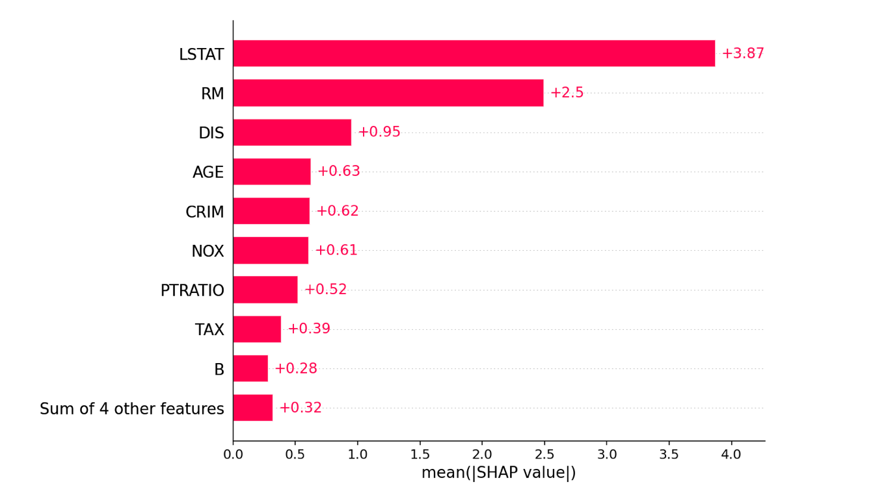
SHAP example 1

Slide 44
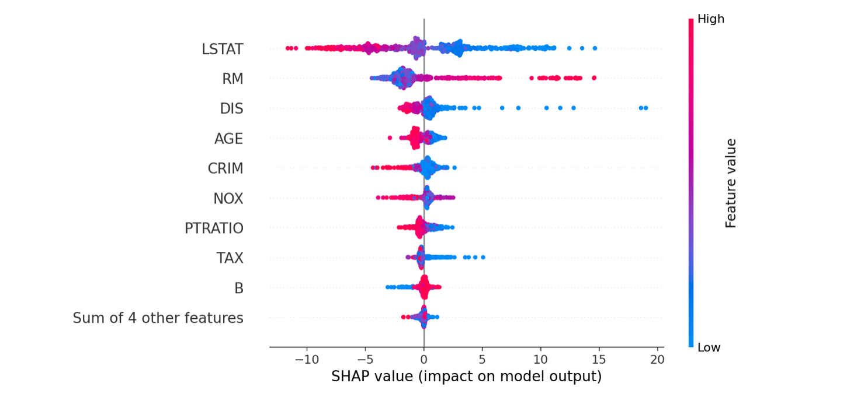
SHAP example 2

Slide 45
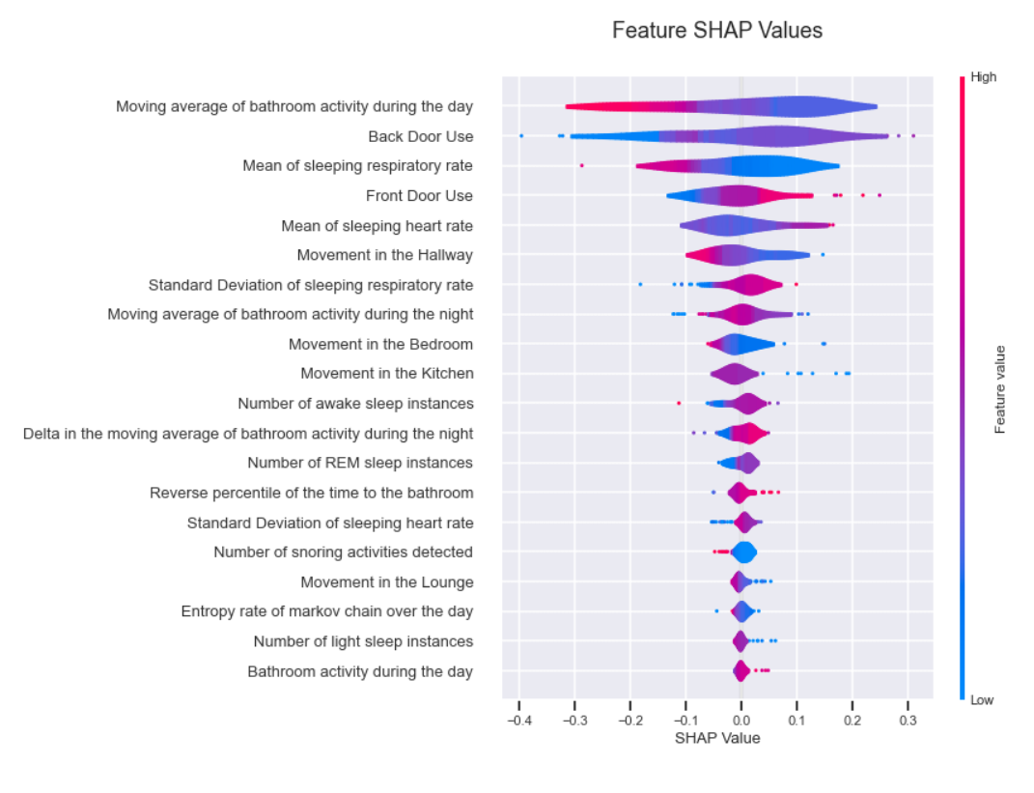
SHAP example 3

Slide 46
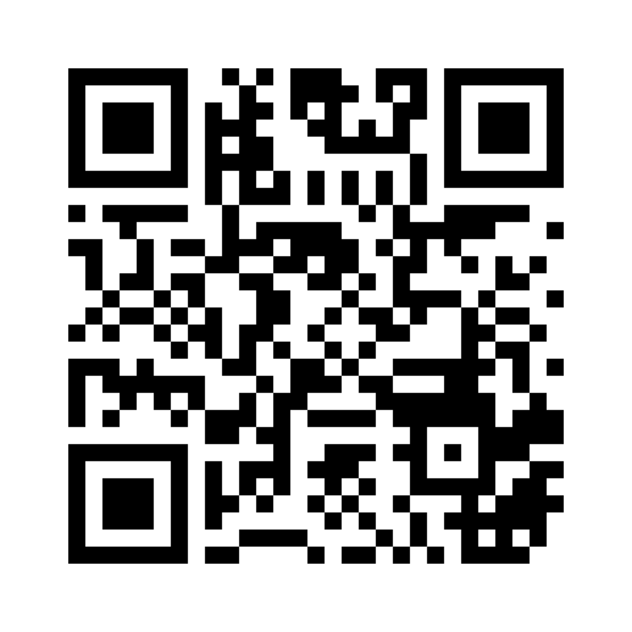
Review questions
Mentimeter code: 1163 0833

Slide 47
Q1 – RF vs DT
If we have a dataset with multiple features in which the samples vary, and the different features contribute to the overall class prediction, which of DT or RF could be a good choice?
menti code will be provided.

Slide 48
Q2
In a Random forest model, when samples are drawn with replacement, what is the method known as?

Slide 49
Q3
In SVM models, there is a hyperparameter known as the Soft Margin of SVM (shown as C in the model implementation). The C hyperparameter introduces a penalty for each misclassified sample.
If you set C to a large value, it will imply a small margin in support vectors. What issue do you think the small margins in support vectors could then cause?

Slide 50
If you have any questions
Please feel free to come and see me (9th Floor, Sir Michael Uren Research Hub, White City Campus) or email (p.barnaghi@imperial.ac.uk).

